Slide 1

DigiBitak
E-commerce program

Slide 2

What is E-Commerce
E-Commerce refers the use of internet and other online services to be engaged in buying and selling of digital and non-digital products and services which require digital transportation or physical transportation.
Examples for E-Commerce are:
1. eBay
2. Amazon
3. OLX

Slide 3


About the project
Our project is a C++ program which aims to help people sell or buy goods and services online.
There are many functions in the program which can help users to find customers and offers easy and fast.

Slide 4




About the code
Our program is written on C++. The IDE which we use is Visual Studio 2019
For communication we used Microsoft Teams. We also used it for communication with our mentor.

Slide 5
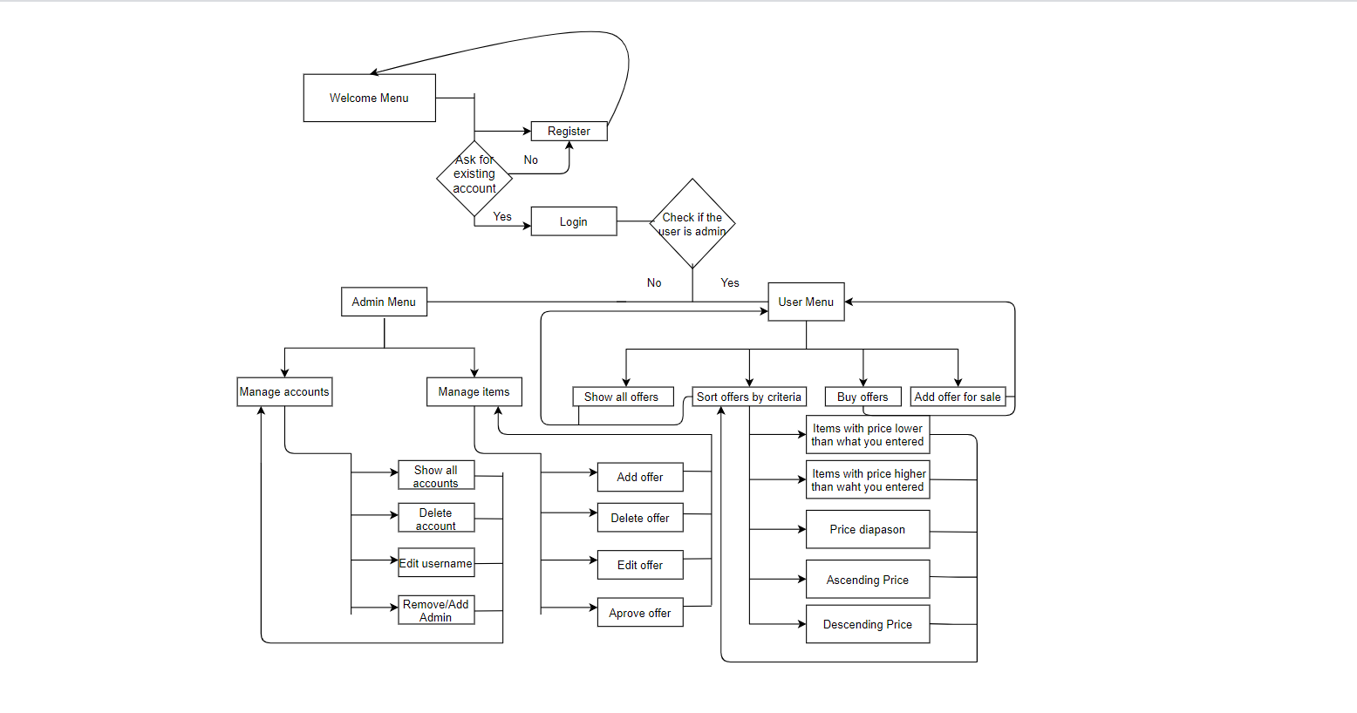
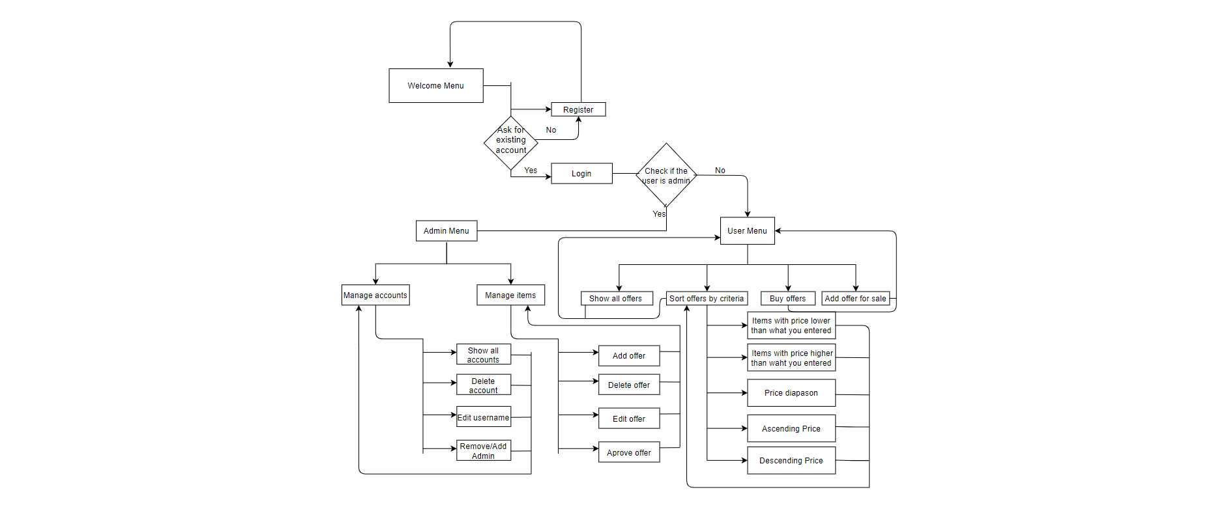

Slide 6
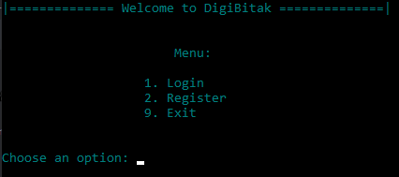
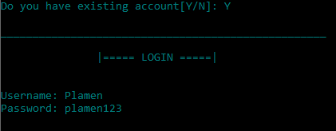
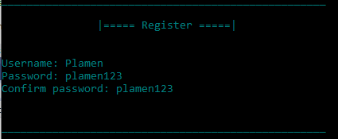
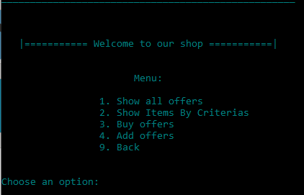

Slide 7
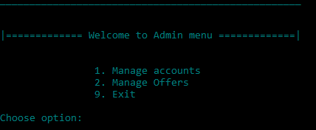
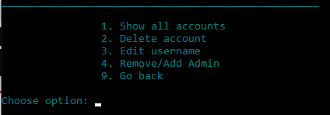
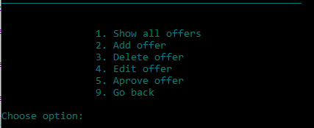

Slide 8
Future Ideas
Code Optimization
Real Database
Make our team bigger

Slide 9

Thank you for your attention!

